Slide 1

SELECTION
SORT
ING

Slide 2
SELECTION
SORT
ING
S

Slide 3

GROUP 1

Slide 4

Hùng Anh
Ngô Long
Đinh Quân
Đức Thành

Slide 5
1. Introduce of selection sorts
2. Example of selection sorts
TABLE CONTENT
3. Selection sorts algorithm
4. Advantages and disadvantages
5. Q&A

Slide 6

1. Introduce of selection sorts
Define:
The selection sort algorithm sorts an array by repeatedly finding the minimum element (considering ascending order) from unsorted part and putting it at the beginning.

Slide 7
1. Introduce of selection sorts
1
j
k
n
Sorted
Unsorted
_Find the smallest element from the unsorted sublist and putting it at the beginning
_The imaginary wall: between two sublists.
_Repeat until the unsorted list is empty

Slide 8
2. Example
6
68
24
1
8
32

Slide 9
2. Example
6
68
24
1
8
32

Slide 10
2. Example
Swap
6
68
24
1
8
32

Slide 11
2. Example
6
68
24
1
8
32

Slide 12
2. Example
1
68
24
6
8
32

Slide 13
2. Example
1
68
24
6
8
32

Slide 14
2. Example
Swap
1
68
24
6
8
32

Slide 15
2. Example
1
68
24
6
8
32

Slide 16
2. Example
1
6
24
68
8
32

Slide 17
2. Example
Swap
1
6
24
68
8
32

Slide 18
2. Example
Swap
1
6
8
68
24
32

Slide 19
2. Example
Swap
1
6
8
24
68
32

Slide 20
2. Example
1
6
8
24
32
64

Slide 21
Selection sorts algorithm

Slide 22
Given list of integers. Ex: n = 3 5 8 1 4
Place the wall at the leftmost part of the bit(beginning with n0)
Compare
Each elements from the wall to find the smallest
[False]
Return for another loop
[True]
Swap the smallest element with first element of unsorted list
Returned: sorted list
Move the wall to the right exactly one element

Slide 23
Pseudocode
The select the option function (array, size)
Repeat (size - 1) times
Set the element not being sorted at least the first element
Use the loops for each section
if element < small element
Set small section of the element
Minimal change of element with first unsorted position
End function

Slide 24
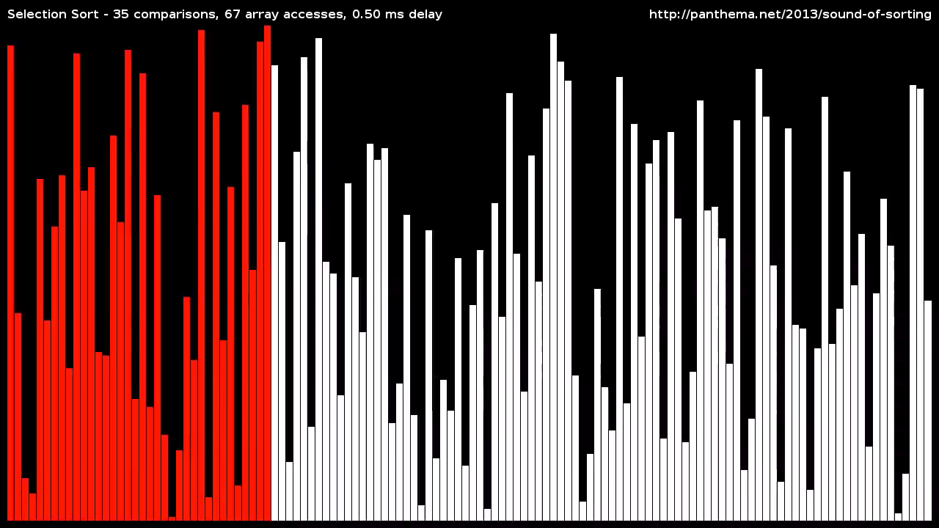

Slide 25


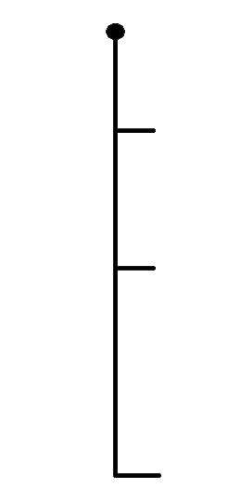






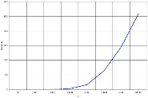
Selection Sort
Advantages
Disadvantages
That is performs well on
a small list
Its poor efficiency when dealing with a huge list of items
Because it is an in-place sorting algorithm, no additional temporary storage is required beyond what is needed to hold the original list.
The selection sort requires
n-squared number of steps for sorting n elements
No additional
Its performance is easily influenced by the initial ordering of the items before the sorting process
Quick sort is much more efficient than selection sort

Slide 26

Q&A

Slide 27
Assignment plan
Presentation:
Nguyễn Đức Thành
Ngô Văn Long
Nguyễn Hùng Anh
Đinh Anh Quân
PPT:
Nguyễn Trung Thành
Lê Bá Khánh Trình
Record:
Trần tiến Dũng
GROUP 1
Leader: Trần Tiến Dũng
Q&A:
Phạm Sơn Nguyên
Nguyễn Phong Lưu
Nguyễn Ngọc Dương

Slide 28

THANK FOR WATCHING

